Slide 1
The d block:
The d block consists of three horizontal series in periods 4, 5 & 6
  10 elements in each series
  Chemistry is “different” from other elements
  Special electronic configurations important
    Differences within a group in the d block are less sharp than in s & p block
    Similarities across a period are greater

Slide 2
Electronic Configuration
Across the 1st row of the d block (Sc to Zn) each element
  has 1 more electron and 1 more proton
  Each “additional” electron enters the 3d sub-shell
  The core configuration for all the period 4 transition elements is that of Ar
    1s²2s²2p⁶3s²3p⁶

Slide 3
Energy
4p
3d
4s
3p
3s
2p
2s
Ar
1s² 2s² 2p⁶ 3s² 3p⁶
1s

Slide 4
Energy
4p
3d
4s
3p
3s
2p
2s
Sc
1s² 2s² 2p⁶ 3s² 3p⁶ 3d¹ 4s²
1s

Slide 5
 |  | Electronic Arrangement
Element | Z |  | 3d |  |  |  |  |  | 4s
Sc | 21 | [Ar] | ↑ |  |  |  |  |  | ↑↓
Ti | 22 | [Ar] | ↑ | ↑ |  |  |  |  | ↑↓
V | 23 | [Ar] | ↑ | ↑ | ↑ |  |  |  | ↑↓
Cr | 24 | [Ar] | ↑ | ↑ | ↑ | ↑ | ↑ |  | ↑
Mn | 25 | [Ar] | ↑ | ↑ | ↑ | ↑ | ↑ |  | ↑↓
Fe | 26 | [Ar] | ↑↓ | ↑ | ↑ | ↑ | ↑ |  | ↑↓
Co | 27 | [Ar] | ↑↓ | ↑↓ | ↑ | ↑ | ↑ |  | ↑↓
Ni | 28 | [Ar] | ↑↓ | ↑↓ | ↑↓ | ↑ | ↑ |  | ↑↓
Cu | 29 | [Ar] | ↑↓ | ↑↓ | ↑↓ | ↑↓ | ↑↓ |  | ↑
Zn | 30 | [Ar] | ↑↓ | ↑↓ | ↑↓ | ↑↓ | ↑↓ |  | ↑↓

Slide 6
Chromium and Copper
Cr and Cu don’t fit the pattern of building up the 3d sub-shell, why?
  In the ground state electrons are always arranged to give lowest total energy
  Electrons are negatively charged and repel each other
  Lower total energy is obtained with e⁻ singly in orbitals rather than if they are paired in an orbital
  Energies of 3d and 4s orbitals very close together in Period 4

Slide 7
Chromium and Copper
At Cr
  Orbital energies such that putting one e⁻ into each 3d and 4s orbital gives lower energy than having 2 e⁻ in the 4s orbital
At Cu
  Putting 2 e⁻ into the 4s orbital would give a higher energy than filling the 3d orbitals

Slide 8
Energy
4p
3d
4s
3p
3s
2p
2s
Cr
1s² 2s² 2p⁶ 3s² 3p⁶ 3d⁵ 4s¹
1s

Slide 9
Energy
4p
3d
4s
3p
3s
2p
2s
Cu
1s² 2s² 2p⁶ 3s² 3p⁶ 3d¹⁰ 4s¹
1s

Slide 10
What is a transition metal?
Transition metals [TM’s] have characteristic properties
  e.g. coloured compounds, variable oxidation states
These are due to presence of an inner incomplete d sub-shell
Electrons from both inner d sub-shell and outer s sub-shell can be involved in compound formation

Slide 11
What is a transition metal?
Not all d block elements have incomplete d sub-shells
  e.g. Zn has e.c. of [Ar]3d¹⁰4s², the Zn²⁺ ion ([Ar] 3d¹⁰) is not a typical TM ion
  Similarly Sc forms Sc³⁺ which has the stable e.c of Ar. Sc³⁺ has no 3d electrons

Slide 12
What is a transition metal?
For this reason, a transition metal is defined as being an element which forms at least one ion with a partially filled sub-shell of d electrons.
  In period 4 only Ti-Cu are TM’s!
  Note that when d block elements form ions the s electrons are lost first

Slide 13
What are TM’s like?
TM’s are metals
They are similar to each other but different from s block metals eg Na and Mg
Properties of TM’s
  Dense metals
  Have high T_{m} and T_{b}
  Tend to be hard and durable
  Have high tensile strength
  Have good mechanical properties

Slide 14
What are TM’s like?
Properties derive from strong metallic bonding
TM’s can release e⁻ into the pool of mobile electrons from both outer and inner shells
  Strong metallic bonds formed between the mobile pool and the +ve metal ions
  Enables widespread use of TMs!
  Alloys very important: inhibits slip in crystal lattice usually results in increased hardness and reduced malleability

Slide 15
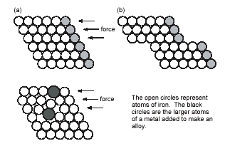
Effect of Alloying on TM’s

Slide 16
TM Chemical Properties
Typical chemical properties of the TM’s are
  Formation of compounds in a variety of oxidation states
  Catalytic activity of the elements and their compounds
  Strong tendency to form complexes
    See CI 11.6
  Formation of coloured compounds
    See CI 11.6

Slide 17
Variable Oxidation States
TM’s show a great variety of oxidation states cf s block metals
If compare successive ionisation enthalpies (ΔH_{i}) for Ca and V as follows
  M(g) → M⁺(g) + e⁻ ΔH_{i}(1)
  M⁺(g) → M²⁺(g) + e⁻ ΔH_{i}(2)
  M²⁺(g) → M³⁺(g) + e⁻ ΔH_{i}(3)
  M³⁺(g) → M⁴⁺(g) + e⁻ ΔH_{i}(4)

Slide 18
ΔH_{i} for Ca and V
Element | Ionisation Enthalpies [kJ mol⁻¹]
 | ΔH_{i}(1) | ΔH_{i}(2) | ΔH_{i}(3) | ΔH_{i}(4)
Ca [Ar]4s² | +596 | +1152 | +4918 | +6480
V [Ar]3d³4s² | +656 | +1420 | +2834 | +4513

Slide 19
ΔH_{i} for Ca and V
Both Ca & V always lose the 4s electrons
For Ca
  ΔH_{i}(1) & ΔH_{i}(2) relatively low as corresponds to removing outer 4s e⁻
  Sharp increase in ΔH_{i}(3) & ΔH_{i}(4) cf ΔH_{i}(2) due to difficulty in removing 3p e⁻
For Sc
  Gradual increase from ΔH_{i}(1) to ΔH_{i}(4) as removing 4s then 3d e⁻

Slide 20
Oxidation States of TM’s
In the following table
  Most important OS’s in boxes
  OS = +1 only important for Cu
  In all others sum of ΔH_{i}(1) + ΔH_{i}(2) low enough for 2e⁻ to be removed
  OS = +2, where 4s e⁻ lost shown by all except for Sc and Ti
  OS = +3, shown by all except Zn

Slide 21
Oxidation States of TM’s
Sc |  | Ti |  | V |  | Cr |  | Mn |  | Fe |  | Co |  | Ni |  | Cu |  | Zn
 |  |  |  |  |  |  |  |  |  |  |  |  |  |  |  | +1
 |  |  |  | +2 |  | +2 |  | +2 |  | +2 |  | +2 |  | +2 |  | +2 |  | +2
+3 |  | +3 |  | +3 |  | +3 |  | +3 |  | +3 |  | +3 |  | +3 |  | +3
 |  | +4 |  | +4 |  |  |  | +4
 |  |  |  | +5
 |  |  |  |  |  | +6 |  | +6 |  | +6
 |  |  |  |  |  |  |  | +7

Slide 22
Oxidation States of TM’s
No of OS’s shown by an element increases from Sc to Mn
  In each of these elements highest OS is equal to no. of 3d and 4s e⁻
After Mn decrease in no. of OS’s shown by an element
  Highest OS shown becomes lower and less stable
  Seems increasing nuclear charge binds 3d e⁻ more strongly, hence harder to remove

Slide 23
Oxidation States of TM’s
In general
  Lower OS’s found in simple ionic compounds
    E.g. compounds containing Cr³⁺, Mn²⁺, Fe³⁺, Cu²⁺ ions
  TM’s in higher OS’s usually covalently bound to electronegative element such as O or F
    E.g VO₃⁻, vanadate(V) ion; MnO₄⁻, manganate(VII) ion
    Simple ions with high OS’s such as V⁵⁺ & Mn⁷⁺ are not formed

Slide 24
Stability of OS’s
Change from one OS to another is a redox reaction
Relative stability of different OS’s can be predicted by looking at Standard Electrode Potentials
  E∅ values

Slide 25
Stability of OS’s
General trends
  Higher OS’s become less stable relative to lower ones on moving from left to right across the series
  Compounds containing TM’s in high OS’s tend to be oxidising agents e.g MnO₄⁻
  Compounds with TM’s in low OS’s are often reducing agents e.g V²⁺ & Fe²⁺

Slide 26
Stability of OS’s
General trends (continued)
  Relative stability of +2 state with respect to +3 state increases across the series
  For compounds early in the series, +2 state highly reducing
    E.g. V²⁺(aq) & Cr²⁺(aq) strong reducing agents
  Later in series +2 stable, +3 state highly oxidising
    E.g. Co³⁺ is a strong oxidising agent, Ni³⁺ & Cu³⁺ do not exist in aqueous solution.

Slide 27
Catalytic Activity
TM’s and their compounds effective and important catalysts
  Industrially and biologically!!
The “people in the know” believe
  catalysts provide reaction pathway with lower E_{A} than uncatalysed reaction (see CI 10.5)
Once again,
  availability of 3d and 4s e⁻
  ability to change OS
  among factors which make TM’s such good catalysts

Slide 28
Heterogeneous Catalysis
Catalyst in different phase from reactants
  Usually means solid TM catalyst with reactants in liquid or gas phases
TM’s can
  use the 3d and 4s e⁻ of atoms on metal surface to from weak bonds to the reactants.
  Once reaction has occurred on TM surface, these bonds can break to release products
Important example is hydrogenation of alkenes using Ni or Pt catalyst

Slide 29

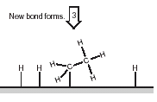
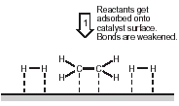
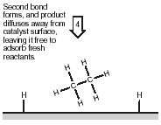
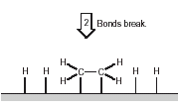
Heterogeneous Catalysis

Slide 30
Homogeneous Catalysis
Catalyst in same phase as reactants
  Usually means reaction takes place in aqueous phase
  Catalyst aqueous TM ion
Usually involves
  TM ion forming intermediate compound with ome or more of the reactants
  Intermediate then breaks down to form products

Slide 31
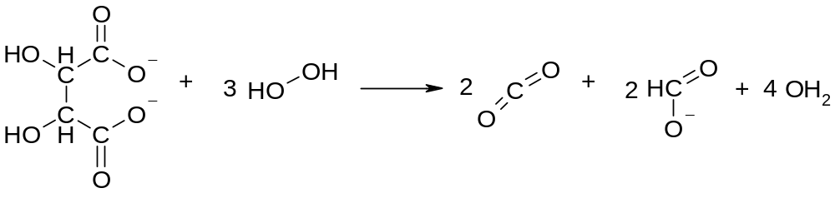
Homogeneous Catalysis
Above reaction is that used in Activity SS5.2
  2,3-dihydroxybutanoate ion with hydrogen peroxide
  Reaction catalysed by Co²⁺

Slide 32
Suggested Mechanism
REACTANTS
H₂O₂ +
⁻O₂CCH(OH)CH(OH)C0₂⁻
Co²⁺ (pink)
INTERMEDIATE
containing
Co³⁺ (green)
Co²⁺ reduces
H₂O₂ & gets oxidised to Co³⁺
Co³⁺ oxidises 2,3-hydroxy- butanoate & gets reduced to Co²⁺
Regenerated
Catalyst
PRODUCTS
CO₂, methanoate, H₂O
Co²⁺ (pink)

Slide 33
This powerpoint was kindly donated to www.worldofteaching.com
http://www.worldofteaching.com is home to over a thousand powerpoints submitted by teachers. This is a completely free site and requires no registration. Please visit and I hope it will help in your teaching.

